Slide 1
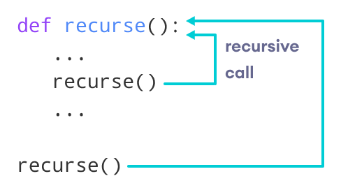
Python Recursion
In this tutorial, you will learn to create a recursive function (a function that calls itself).
What is recursion?
Recursion is the process of defining something in terms of itself.
A physical world example would be to place two parallel mirrors facing each other. Any object in between them would be reflected recursively.
Python Recursive Function
In Python, we know that a function can call other functions. It is even possible for the function to call itself. These types of construct are termed as recursive functions.
The following image shows the working of a recursive function called

Slide 2
Following is an example of a recursive function to find the factorial of an integer.
Factorial of a number is the product of all the integers from 1 to that number. For example, the factorial of 6 (denoted as 6!) is
1*2*3*4*5*6 = 720
Example of a recursive function
def factorial(x): """This is a recursive function to find the factorial of an integer""" if x == 1: return 1 else: return (x * factorial(x-1)) num = 3 print("The factorial of", num, "is", factorial(num))
Output
The factorial of 3 is 6

Slide 3
When we call this function with a positive integer, it will recursively call itself by decreasing the number.
Each function multiplies the number with the factorial of the number below it until it is equal to one. This recursive call can be explained in the following steps.
factorial(3) # 1st call with 3
3 * factorial(2) # 2nd call with 2
3 * 2 * factorial(1) # 3rd call with 1
3 * 2 * 1 # return from 3rd call as number=1
3 * 2 # return from 2nd call 6 # return from 1st call

Slide 4
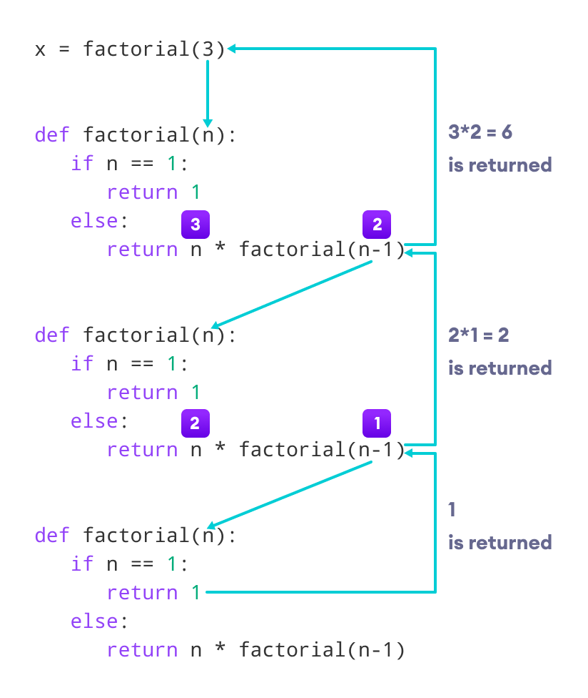
Let's look at an image that shows a step-by-step process of what is going on:
def factorial(x):
if x == 1:
return 1
else:
return (x * factorial(x-1))
num = 4
print("The factorial of", num, "is", factorial(num))

Slide 5
Our recursion ends when the number reduces to 1. This is called the base condition.
Every recursive function must have a base condition that stops the recursion or else the function calls itself infinitely.
The Python interpreter limits the depths of recursion to help avoid infinite recursions, resulting in stack overflows.

Slide 6
Python Lambda
A lambda function is a small anonymous function.
A lambda function can take any number of arguments, but can only have one expression.
In Python, a lambda function is a single-line function declared with no name, which can have any number of arguments, but it can only have one expression. Such a function is capable of behaving similarly to a regular function declared using the Python's def keyword.
lambda arguments : expression
x = lambda a : a + 10 print(x(5))
x = lambda a, b : a * b print(x(5, 6))
Why Use Lambda Functions?
use them as an anonymous function inside another function.
def myfunc(n): return lambda a : a * n mytripler = myfunc(3) print(mytripler(11))

Slide 7
Task 1:
Write a recursive function to calculate the sum of numbers from 0 to 10(10+9+8+…0)
Task2:
Write a Python program to find whether a given string starts with a given character using Lambda.
Write a Python program to extract year, month, date and time using Lambda.

Slide 8
Task 1:
Write a Python program to find whether a given string starts with a given character using Lambda.
starts_with = lambda x: True if x.startswith('P') else False
print(starts_with('Python'))
starts_with = lambda x: True if x.startswith('P') else False
print(starts_with('Java'))
def calculateSum(num):
if num:
return num + calculateSum(num-1)
else:
return 0
res = calculateSum(10)
print(res)

Slide 9
Write a Python program to extract year, month, date and time using Lambda.
import datetime
now = datetime.datetime.now()
print(now)
year = lambda x: x.year
month = lambda x: x.month
day = lambda x: x.day
t = lambda x: x.time()
print(year(now))
print(month(now))
print(day(now))
print(t(now))
https://www.w3resource.com/python-exercises/lambda/index.php#EDITOR

